Slide 1

Project Title –VOIS MAJOR PROJECT PPT
[Student Name RUSHIKESH MAHENDRA GOGULA
College Name-SASMIRA INSTITUTE OF COMMERCE AND SCIENCE ]
AICTE STU ID : STU6a619feb072c31784782827

Slide 2

PROBLEM STATEMENT
Agricultural activities are influenced by seasonal variations in environmental conditions, farming practices, resource availability and market conditions. As a result, agricultural performance may differ from one season to another. However, raw agricultural data does not clearly explain how agricultural performance changes across seasons or what patterns can be observed in different seasonal conditions. The problem is to analyze the given agricultural dataset and investigate seasonal differences in agricultural performance by identifying meaningful patterns, trends, relationships and variations within the available data.

Slide 3
Project Description
The project focuses on analyzing agricultural data collected across different seasons, crops, geographical areas and farming conditions.
The dataset contains information about environmental conditions, irrigation methods, crop yield, production, water usage, water efficiency, market prices, costs and profits.
The data was explored, cleaned and analyzed using statistical techniques and data visualization methods.
The analysis compares agricultural performance across seasons, irrigation methods and crops and investigates relationships between environmental factors and agricultural outcomes.
The main aim is to generate meaningful insights that can support evidence-based agricultural planning.

Slide 4

WHO ARE THE END USERS?
• Farmers and agricultural producers
• Agricultural planners and consultants
• Government and agricultural departments
• Agricultural researchers and students
• Organizations involved in agricultural resource management

Slide 5

Technology Used
  • Python – Data analysis and programming
  • Pandas – Data loading, cleaning and analysis
  • NumPy – Numerical operations
  • Matplotlib – Data visualization
  • Seaborn – Statistical visualizations
  • SciPy – Statistical analysis and ANOVA
  • Google Colab / Jupyter Notebook – Development and execution environment

Slide 6
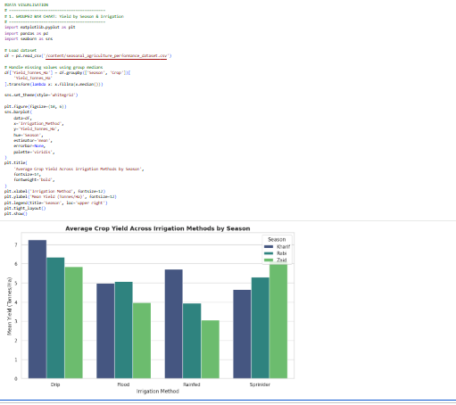
RESULTS
Title:
Average Crop Yield Across Irrigation Methods by Season
Explanation:
The grouped bar chart compares the average crop yield for different irrigation methods across Kharif, Rabi and Zaid seasons.
It helps identify how irrigation methods are associated with agricultural productivity under different seasonal conditions.
The analysis shows differences in average yield between irrigation methods, with Drip irrigation showing the highest overall average yield among the methods analyzed.
This visualization helps compare productivity and understand the role of irrigation practices in agricultural performance.

Slide 7
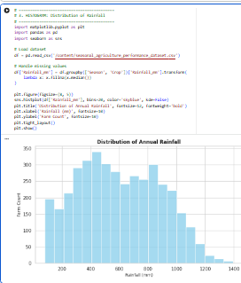
RESULTS
Title:
Distribution of Rainfall
Explanation:
The histogram shows how rainfall values are distributed across the agricultural dataset.
It helps understand the range and frequency of different rainfall levels recorded in the farms.
The dataset contains rainfall values ranging from approximately 80 mm to 1395 mm, showing considerable variation in rainfall conditions.
This visualization is useful for understanding the environmental conditions represented in the dataset and identifying the overall distribution of rainfall.

Slide 8
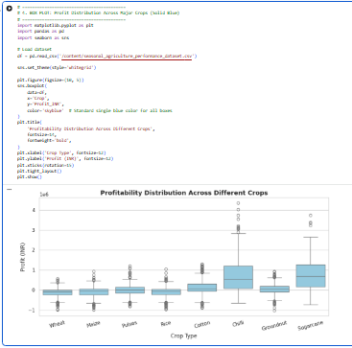
RESULTS
Title:
Profit Distribution Across Major Crops
Explanation:
The box plot compares the distribution of agricultural profit across different crops.
It helps identify the median, spread and variation of profit values and highlights differences between crops.
The crop-wise analysis shows substantial differences in profitability. Sugarcane and Chilli show strong average profitability, while Wheat, Rice and Maize have negative average profit values in the dataset.
The visualization demonstrates that agricultural profitability can vary considerably between crops.

Slide 9
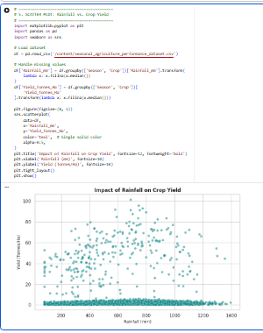
RESULTS
Title:
Relationship Between Rainfall and Agricultural Yield
Explanation:
The scatter plot examines the relationship between rainfall and agricultural yield.
Each point represents an observation from the dataset, while the different seasons help compare observations under different seasonal conditions.
The points do not show a strong visible linear relationship between rainfall and yield.
The statistical analysis also shows a very weak positive correlation between rainfall and yield, with a correlation coefficient of approximately 0.03.
Therefore, rainfall alone does not appear to explain much of the variation in yield in this dataset.

Slide 10
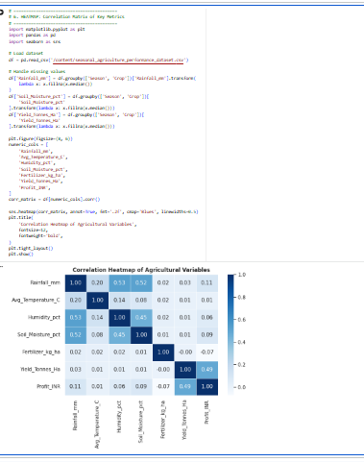
RESULTS
Title:
Correlation Heatmap of Agricultural Variables
Explanation:
The heatmap shows the strength and direction of relationships between important numerical agricultural variables.
The strongest positive relationship with yield is observed for Water Efficiency, with a correlation of approximately 0.92.
Profit has a moderate positive relationship with yield at approximately 0.49, while Water Used has a moderate positive relationship of approximately 0.39.
Rainfall, temperature, humidity, soil moisture and fertilizer usage show very weak linear relationships with yield.
The heatmap helps identify the variables that are most strongly associated with agricultural yield.

Slide 11
Future scope
• Develop predictive models for crop yield and profitability.
• Use larger and more recent agricultural datasets.
• Include real-time weather and soil data.
• Develop crop-specific recommendation systems.
• Build interactive dashboards for farmers and agricultural planners.
• Analyze regional and district-level agricultural patterns.
• Use machine learning to predict seasonal agricultural performance.
• Integrate market-price forecasting for better crop planning.

Slide 12
GitHub Link

Slide 13
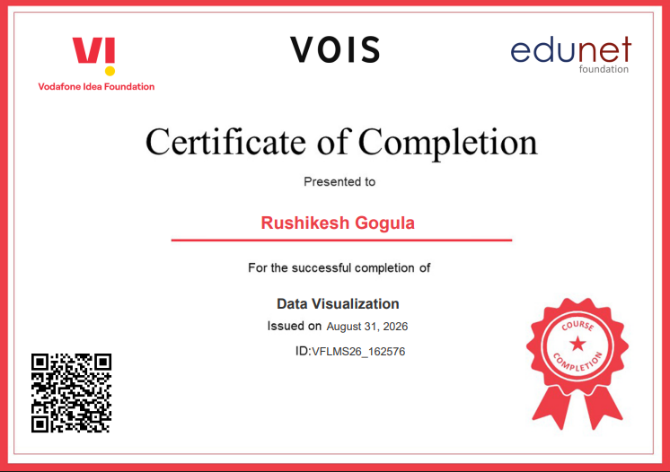
VOIS Course completion certificate - RUSHIKESH DATA VISULAISATION CERTIFICATE
Course name- Data Visualization

Slide 14
Thank you
.
.

